Slide 1
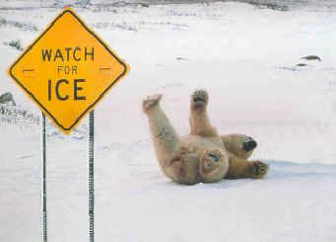
Friction
This lesson will introduce you will learn about the Normal Force and the Force of Friction
You will also learn how to solve dynamic problems involving these forces.

Slide 2
Learning Goals
By the end of this lesson, you will be able to:
define Normal Force and Force of Friction
determine the factors that affect friction
solve problems involving friciton

Slide 3
Success Criteria
Can I:
define Normal Force
define the Force of Friction
explain why friction only depends on the normal force
solve dynamic related problems with friction

Slide 4
The normal force
an action force to a surface causes a reaction force
this force is called the normal force, F_{N}
ex: when you stand on the floor your feet are pressing
down on the floor
the normal force is the reaction force of the floor
pushing back on your feet.
F_{N} is always perp to the surface

Slide 5

Sample Problem
Ex 1: A person of mass 40. kg is sitting on a box.
What is the normal force?
Sol’n:
The normal force is the force that the box pushes
back on the person. In this case it must be equal
to the force of gravity on the person in magnitude.

Slide 6
To understand this more clearly we draw a FBD of
the person.
These two force must balance each
other out to give a net force of 0 N.
+
F_{N}
F_{g}
∴ the normal force on the person is 390 N [U]

Slide 7
Sample Problem
Ex 2: Now suppose a friend is trying to lift the person
on the box in example 1 with a crane. The crane
exerts an upward force of 92 N, but the person
does not move. Calculate the normal force.
Sol’n:
In this case there are three forces acting on him
1. The force of gravity
2. The normal force
3. The force of the crane

Slide 8
These three forces must balance each
other out to give a net force of 0 N.
Therefore,
+
F_{N}
F_{crane}
F_{g}
∴ the normal force on the person is 3.0 x 10² N [U]

Slide 9
the normal force is not equal to the weight of the
person
Since the crane exerts an upward force of 92 N on the
person, the person does not push on the box with as
much force.
the box pushes back with less force.

Slide 10
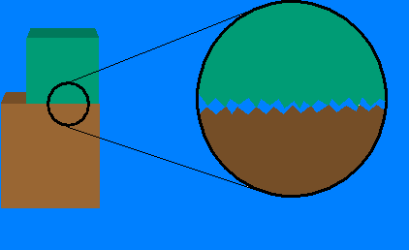
Friction
Physicists don’t entirely understand friction.
friction is caused by microscopic welds.
for an object to move, it must break these welds
Microscopic
welds

Slide 11
The magnitude of the frictional force is determined by
the materials in contact; and
by the normal force exerted by one object on
the other.
There are two types of frictional forces:
1. Static friction
- friction when an object is still
2. Kinetic friction
- friction when an object is moving

Slide 12
There is a coefficient of static friction μ_{s} and a
coefficient of kinetic friction μ_{k}
Each must be used to calculate the friction separately

Slide 13
Sample Problem
Ex 3: A 3.0 kg block of wood sits on a horizontal floor. The largest horizontal force that can be applied to the block before it will start moving is 14.7 N. Once the block starts moving, it only takes 8.8 N to keep it moving at a constant velocity.
(a) Calculate the coefficient of static friction for the block and the floor.
(b) Determine the force of friction acting on the block if a horizontal force of 6.8 N [E] acts on the block.
(c) Determine the coefficient of kinetic friction.

Slide 14
Sol’n a:
next we draw a FBD
F_{N}
m = 3.0 kg
F_{smax}
F_{amax} = 14.7N
F_{g} = 29.4 N

Slide 15
since the block just starts to move if 14.7 N we can assume the block is initially at rest as the 14.7 N is applied

Slide 16
∴ The coefficient of static friction is 0.50
Sol’n b: Since 6.4 N < 14.7 N, the block can’t move. So F_{s} = 6.4 N [W]

Slide 17
Sol’n b:
since the block moves at constant vel, F_{netx} = 0
F_{N}
m = 3.0 kg
F_{k}
F_{a} = 8.8 N
F_{g} = 29.4 N

Slide 18
∴ The coefficient of kinetic friction is 0.30

Slide 19
HOMEWORK
Read Section 4.2
Review Tutorial 1
Questions 1 – 3 pg 171
1 – 7 pg 172

